Slide 1

Sector Strategies & Career Pathways Update
April 28, 2021
Keala Peters
EVP, Education & Workforce Development
Executive Director, Sector Partnerships
Chamber of Commerce Hawaii
Anna Pacheco
Project Director
SMS Research

Slide 2
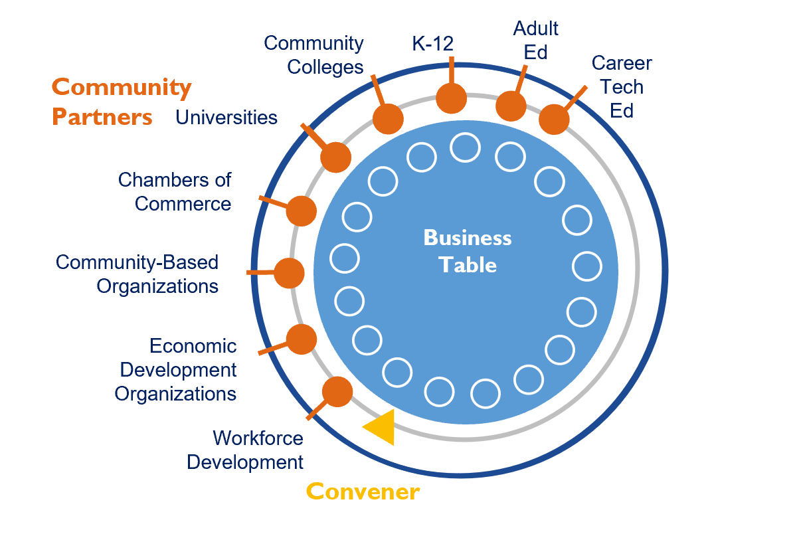
Sector Partnerships:
Industry-driven Employer Partnerships
Engineering
Oahu (Chamber, WDC)
Kauai (KEDB, Chamber, WDC)
Healthcare
Oahu (Chamber, WDC)
Maui (MEDB)
Statewide – in development
Agriculture
Hawaii Island (HIAP, HIFA, Hamakua Inst)
Technology
Statewide – under evaluation
(Chamber + TBD partners)

Slide 3


Convening & Funding Through the Years
2017 – 2020
  Convened by UH and Chamber of Commerce Hawaii
  Funded by Strada Education Network and Harold KL Castle Foundation
  Support provided by Oahu Workforce Development Board
2021 (Jan – July)
  Convened by Chamber + Workforce Development Council
  Funded by Workforce Development Council
  Convening support provided by SMS Research
  Extending reach statewide
2021 (July - Dec)
  Continue Engineering and Healthcare
  Evaluating addition of Technology
  Extending reach statewide
  Requesting WDC/DLIR extend as co-convener through end of year
2022
  Seeking Federal, State grants

Slide 4
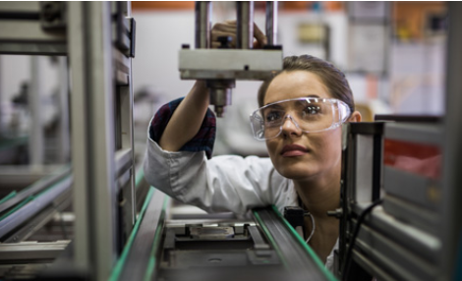
Engineering Partnership Update

Slide 5
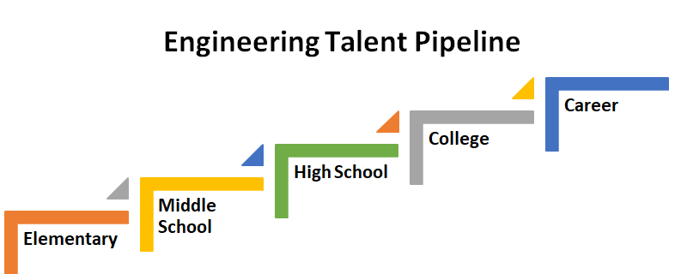
2021 ENGINEERING SP RESPONSE:
Build a K-Career Engineering Pathway
Pilot School Complexes: Campbell, Castle & Waipahu

Slide 6
Expanding the Engineering Sector Partners
The 32 industry partners marked in bold are directly partnering with one or more of our pathway project school complexes.
AECOM
Agor Jehn Architects
Akinaka & Associates, Ltd.
Architects Hawaii Ltd.
Army Corps.
ASCE
ATA Hawai‘i
Austin, Tsutsumi & Associates, Inc.
BAYER
Bechtel
Belt Collins Hawai‘i
Bills Engineering, Inc.
Booz Allen Hamilton
Bowers + Kubota Consulting, Inc
Burns & McDonnell Engineering Company
Carollo Engineers
Coffman Engineers, Inc.
Community Planning & Engineering
Consulting Structural Hawaii, Inc.
Dept. of Environmental Services
Dept. of Planning and Permitting
Dept. of Transportation
ECS Inc.
Electech Hawaii, Inc.
Ferraro Choi
Fukunaga & Associates, Inc.
G70
Geolabs
Gray, Hong, Nojima
Hawaii Board of Water Supply
Hawaii Unified
Hawaiian Dredging Construction
Hawaiian Electric Co.
HDR Engineering, Inc.
Healy Tibbits Builders Inc.
Hi.arch.y LLP
InSynergy Engineering, Inc.
Jacobs Engineering
KAI Hawaii
KCS Consulting, LLC
Kennedy Jenks
Layton Construction Co
Limtiaco Consulting Group
Lowney Architecture
Makaha Learning Center
Martin Defense Group
Mason Architects, Inc.
Michael Young
Miyashiro & Associates, Inc
MK Engineers, Ltd.
MKE Associates, LLC
Nagamine Okawa Engineers, Inc.
Nakamura, Oyama & Associates
NAVFAC
Nordic PCL
Notkin Hawaii, Inc.
Obayashi Design Group Inc
Oceanit
Okahara & Associates, Inc
Orion Engineers
OTIS
Pacific American Foundation
Pacific Geotechnical Engineers, Inc.
Park Engineering
QRSE, LLC
R.M. Towill Corp.
RIM Architects, LLC
Ronald N.S. Ho & Associates, Inc
Sam O. Hirota, Inc.
Sato & Associates
Shigemura, Lau, Sakanashi, Higuchi & Associates
SPAWAR Systems Center Pacific
SSFM International
Structural Hawaii, Inc.
Tanimura & Associates, Inc. (i3ngineering)
Thermal Engineering Corp.
Wilson Okamoto Corp.
WSP Parsons Brinkerhoff
Yogi Kwong Engineers

Slide 7





FOUR SHARED PRIORITIES
Our discovery phase has yielded these shared priorities among our three school complexes (Waipahu, Campbell, Castle):
Increasing understanding of
Engineering Disciplines
Increasing Interest among Female Engineering Students
Ensuring students are Math-Ready
Recruiting Advisory
Board Members
Exposure to various career paths within the Engineering industry, with awareness opportunities ideally beginning at the elementary-school level.
Women in STEM
Exposure to various engineering careers with an increasing number of women employees
Exposing students to the math requirements needed to stay on track while in the K-12 pipeline, to be able to meet university requirements and expectations
Convening industry and education partners to serve on an advisory board tasked with streamlining and strengthening WBL efforts within the school complex
Project Based Learning (PBL) will be a foundational element across the first three priorities.

Slide 8
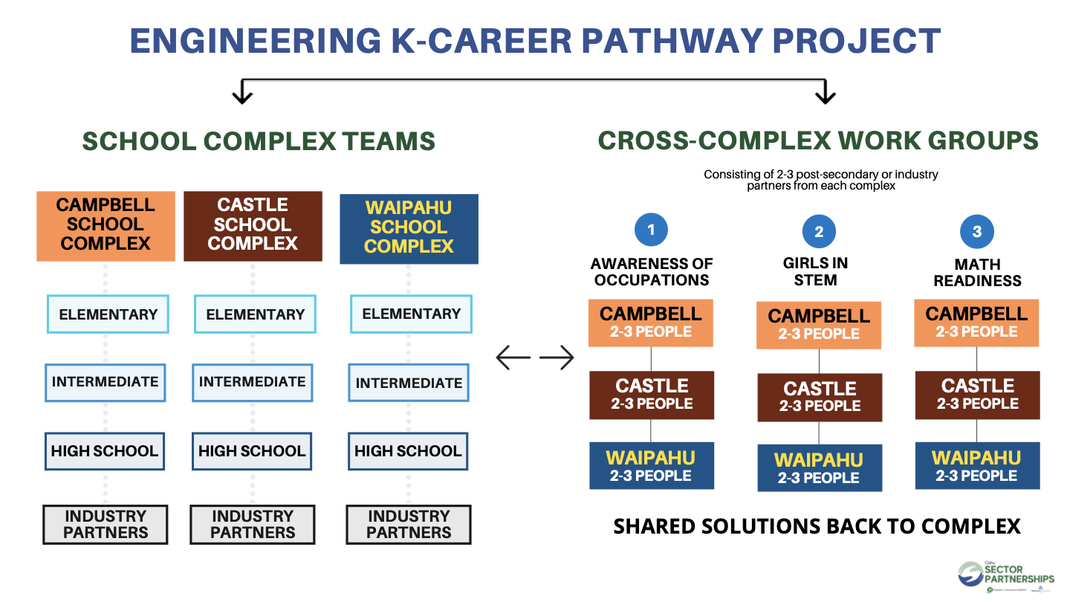

Slide 9

Expanding the Engineering Sector Partnership to Kauai
The convening team is working with Kauai Economic Development Board and Kauai Tech Group to extend K-Career Engineering Pathway Project to Kauai.
Next steps include sharing of strategies, structure, and metrics being used on Oahu for planned next steps on Kauai. Kauai will be sharing work to date and available data with convening team for feedback. The Kauai group is planning to meet monthly with the convening team.

Slide 10
2021 and Next Steps
Jan/Feb 2021 - Pilot school complexes met to plan for industry meetings and confirm priorities.
February 24, 2021 - Full Sector Partnership meeting with all industry and pilot school complex teams.
March 2021 - 18 new Industry partners matched to pilot school complexes!
April 2021 - Pilot school complexes met with new industry partners to share programming and engage industry in support opportunities.
May 11, 2021 - Full Sector Partnership meeting to allow for pilot school complex updates and to kick-off cross-complex workgroups meetings.
Summer - Workgroups complete 1 – 2 pilot projects

Slide 11
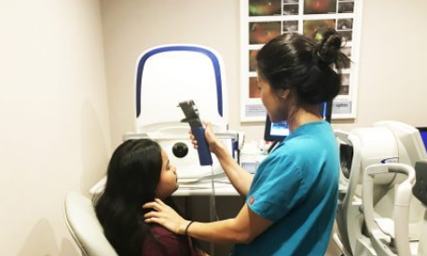
Healthcare Partnership Update

Slide 12
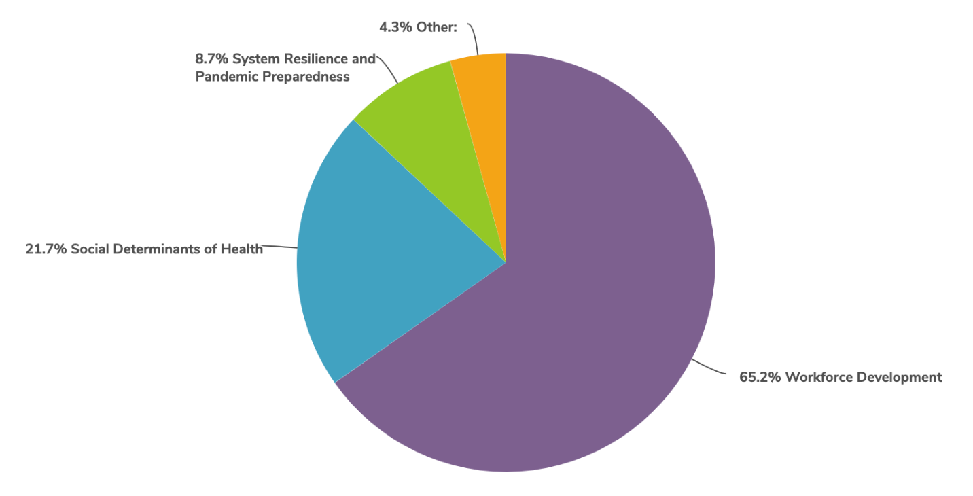
2021 Direction and Priorities
The convening team surveyed the full Healthcare Sector Partnership to clarify 2021 priorities that emerged in the Dec 2020 meeting. A clear majority of respondents felt the partnership should focus on supporting workforce development efforts.

Slide 13
Workforce Development
The convening team has engaged with key partnership leaders to clarify the workforce efforts already in process and identify how the partnership can support and leverage that work.
The partnership will be receiving a full report from Healthcare Association of Hawaii (HAH) and Hawaii 2.0 in May to identify alignment and opportunities for collaboration.

Slide 14
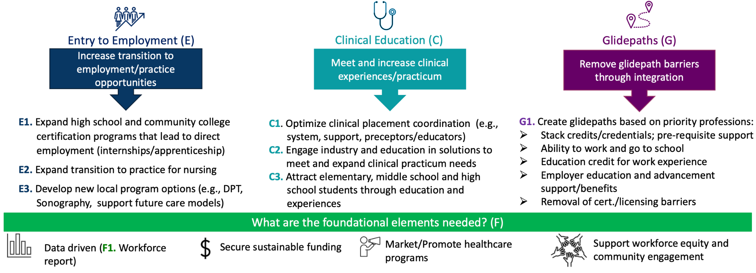
Supporting HAH’s Workforce Initiatives

Slide 15
2021 and Next Steps
January 2021 - Review December meeting results to draft priorities for 2021.
Feb/March 2021 - Outreach to partnership leaders and members survey to confirm priorities.
April 2021 - Connecting with key stakeholders in healthcare workforce development to clarify landscape and prepare for partnership meeting in May.
May 6, 2021 - Full Sector Partnership meeting to receive updates from HAH and Hawaii 2.0. Will focus on collaboration opportunities for the partnership.
May 2021 – Engage statewide leaders for broader scope

Slide 16

Technology Sector Partnership

Slide 17








Technology Workforce In The Classroom

Slide 18


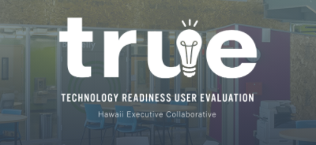
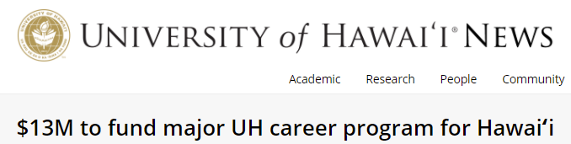
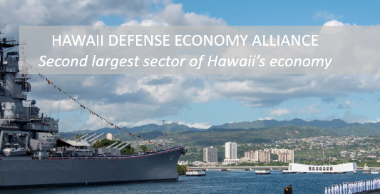



Technology Workforce In The Community
Talent Roadmap to Recovery
Hawaii Defense Economy (HDE) Alliance: DBEDT grant to Chamber MAC, CyberHI etc
Hawaii 2.0
HEC TRUE Initiative: tech-enable Hawaii businesses
Hana Career Pathways: tech apprenticeships, credentials
Individual Corporations
and more…

Slide 19
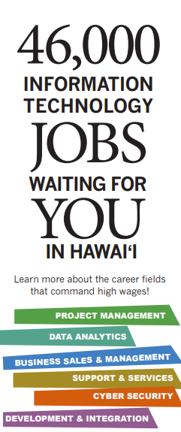
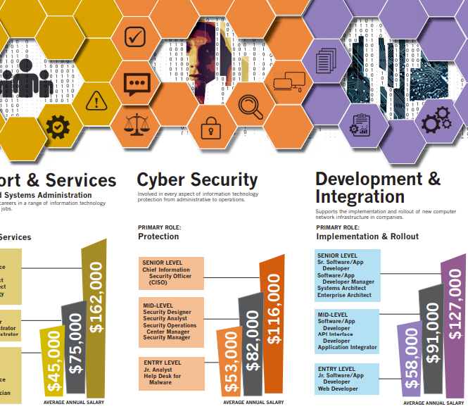
Tech Sector Partnership 2016 - 2017
Career Awareness
Mentorship
Experiential Learning

Slide 20
Is This The Right Time to Reconvene Technology?
To provide a common forum to engage existing groups across the Technology spectrum?
To amplify collaboration?
To support Hawaii’s innovation economy and workforce diversification?

Slide 21
Hawaii Technology Needs Report
Talent pipeline landscape report would provide analysis on:
  Supply and Demand overview
  Skills and Competencies
  Career Pathways for key entry level positions
  Certifications
  Internships and Apprenticeships

Slide 22
Next Steps
Spring: Continue to socialize idea (DBEDT, community partners); identify outcomes/measures; determine funding model; go/no go decision
Summer: Design the Needs Report; conduct comprehensive employer survey
Fall: Report provides draft recommendations
Fall: Industry (SP) determines priorities/actions

Slide 23
Brief Discussion Regarding
Technology Expansion

Slide 24
Convening & Funding Through the Years
2017 – 2020
  Convened by UH and Chamber of Commerce Hawaii
  Funded by Strada Education Network and Harold KL Castle Foundation
  Support provided by Oahu Workforce Development Board
2021 (Jan – July)
  Convened by Chamber + Workforce Development Council
  Funded by Workforce Development Council
  Convening support provided by SMS Research
  Extending reach statewide
2021 (July - Dec)
  Continue Engineering and Healthcare
  Evaluating addition of Technology
  Extending reach statewide
  Requesting WDC/DLIR extend as co-convener through end of year
2022
  Seeking Federal, State grants

Slide 25
Funding Request
Requesting WDC/DLIR extend as co-convener at least through end of 2021
Seeking $40,000 - $60,000, pending WDC budget availability, to retain SMS Research to facilitate for WDC
This would include continuation of Engineering and Healthcare, statewide expansion, and possible expansion to Technology

Slide 26
Mahalo for your partnership!

